Slide 1
Hospital Readmission(1999-2008)
Abhinav Kumar

Slide 2
AIM
The project will be divided into the following stages:
Data Extraction: The first stage of the project will involve extracting data from the Edmunds API using Python. The data will include information on used car prices, specifications, and reviews.
Data Cleaning and Pre-processing: Once the data is extracted, the next stage will involve cleaning and pre-processing the dataset. This will involve handling missing values, removing duplicates, correcting data types, and handling outliers.
Exploratory Data Analysis: Once the data is cleaned and pre-processed, the next stage will involve exploring the data to gain insights and identify patterns. This will involve visualizations and statistical analysis.
Feature Engineering: Based on the insights gained from the exploratory data analysis, the next stage will involve feature engineering to create new features that can help improve the performance of the machine learning model. 5. Model Building and Evaluation: The final stage of the project will involve building and evaluating a machine learning model that can predict the price of a used car. The model will be trained on a subset of the data and evaluated using various performance metrics such as accuracy, precision, recall, and F1 score

Slide 3
DATA SET
The given dataset has many terms which can be divided into different subsets:
Patient data: Race, Gender, Age, Weight
Hospital Entry data:Admission type, Discharge disposition, Admission source, Time in hospital
Medicine and other health data: Number of diagnoses, Primary and Secondary diagnoses , Medications prescribed
Test : Glucose serum test, Hemoglobin test Readmission : <30 days, >30 days or No readmission.

Slide 4
Cleaning the data
To clean the data we have multiple levels
1. First we have to remove the null values
2. Drop the columns which have lot of null values
3. Drop the duplicate values
4. Clean the string impurities using the replace

Slide 5
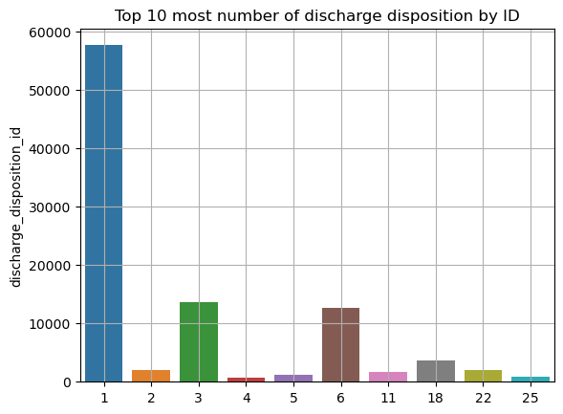
Data visualization

Slide 6
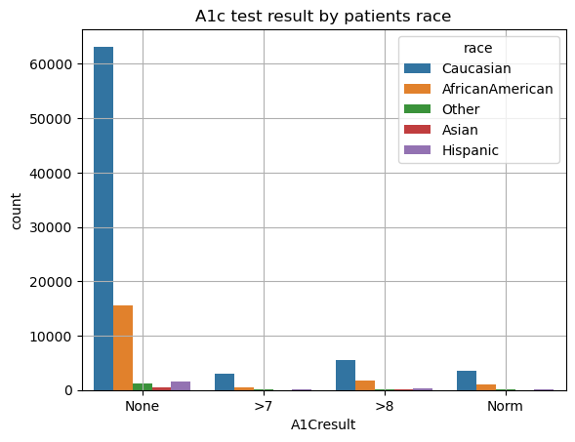
Data visualization

Slide 7
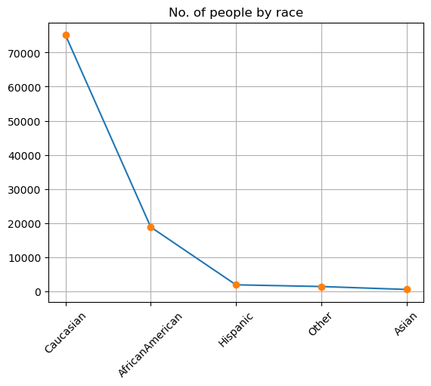
Data visualization
Caucasian people in general have very high chances of being a diabetic

Slide 8
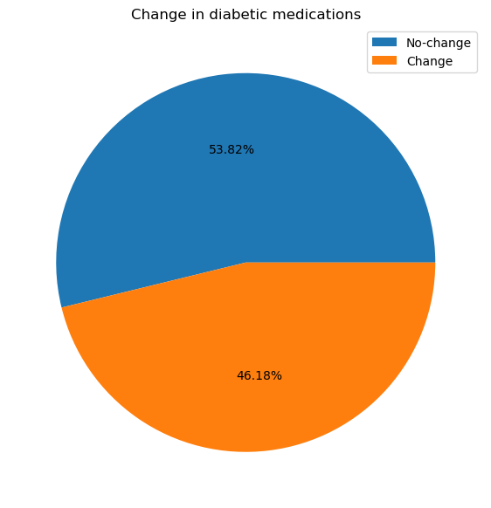
Data visualization
As we can see even after admission almost 60 percent of people have no change in medicines

Slide 9
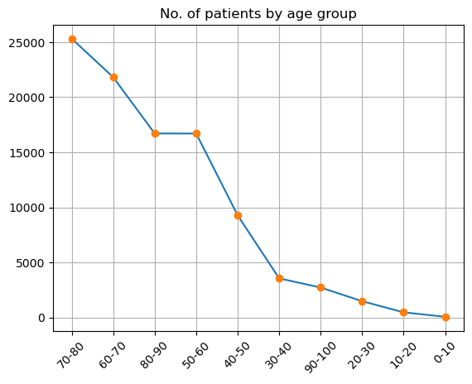
Data visualization
We can see diabetes increases exponentially with age

Slide 10
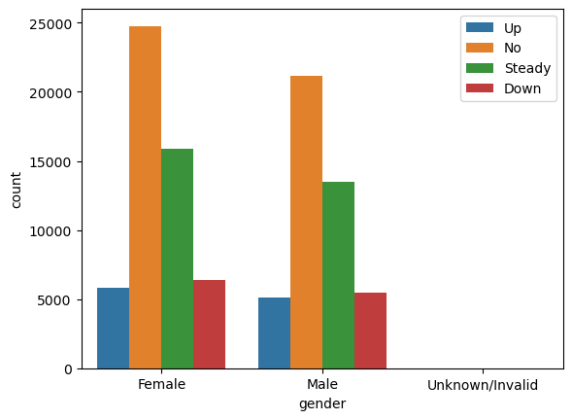
Data visualization

Slide 11
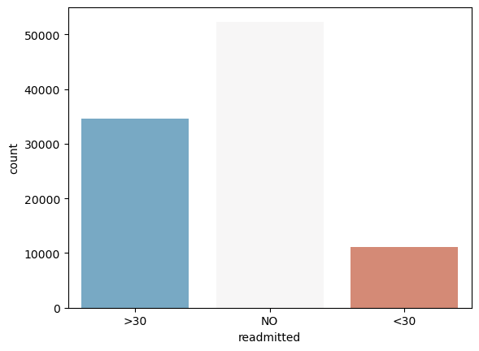
Data visualization

Slide 12
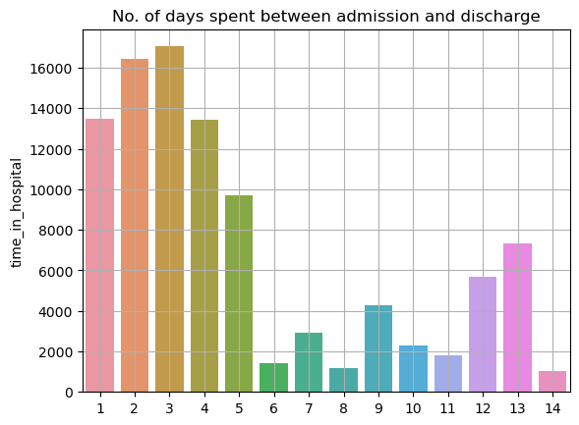
Data visualization

Slide 13
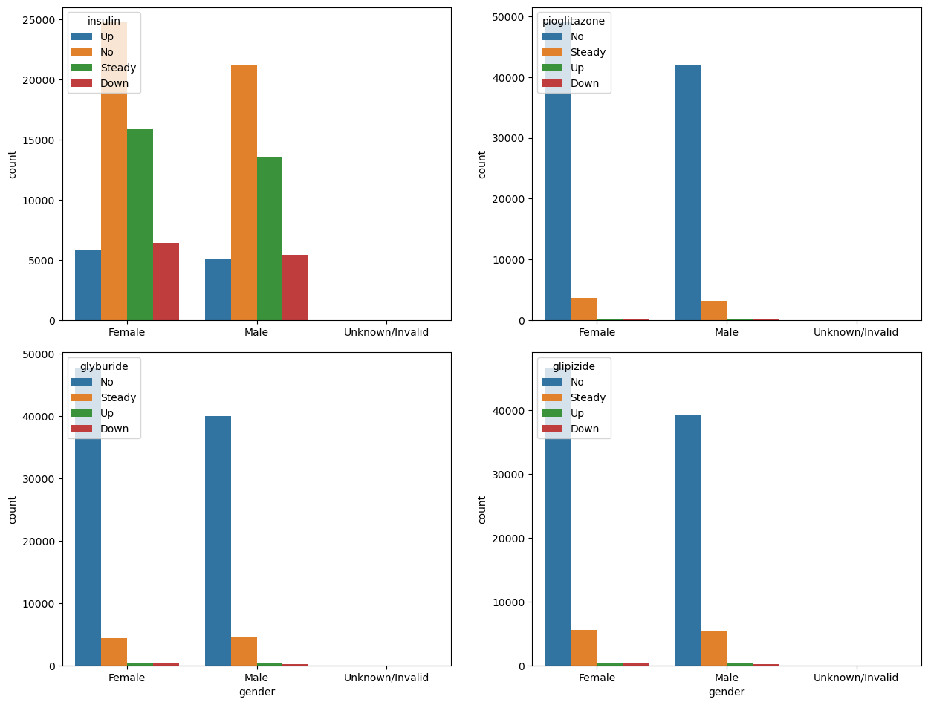
Data visualization

Slide 14
Machine Learning
For machine learning process we have to first draw the correlation heatmap to check the correlation.
Form X and Y parts form ml model.
Preform a train test split.
Standardise the data using standard scaler.
Use degree of dimensionality to use only required columns.
Use randomunsampler to balance the data.
Execute different machine learning model.
Using different Naive Bias and classifiers to see weather it improves the ml model output.

Slide 15
Conclusion
so after preforming different ml processes we realized the most ideal model for this data is logistic regression model which was bit expected but after using different ensemble learning we realized using xg boost at depth 2 we get the best model

